Slide 1
SOFTWARE REQUIREMENT SPECIFICATION 3-SEVEN TETRIS BY .DUEL
LIM PEI YONG 36732
WILLIAM NGU WEE HONG 39322
ABDUL RAHIM BIN MOHAMAD 35282
LIM CHONG FATT 36712
HOE YOU TIEN 36249

Slide 2
INTRODUCTION
Purpose
Scope
Definition

Slide 3
PURPOSE
To provide detailed description of 3-SEVEN Tetris
Cover:
Game interface
Gameplay
Game constraints

Slide 4
SCOPE
Must be able to run as normal tetris game
Able to apply 3-SEVEN game logic on tetris
Able to record high scores
Able to play in a multiplayer environment

Slide 5
OVERALL DESCRIPTION
GAME PERSPECTIVE
GAME FUNCTIONALITY
OPERATING ENVIRONMENT
DESIGN & IMPLEMENTATION CONSTRAINTS
ASSUMPTIONS & DEPENDENCIES

Slide 6
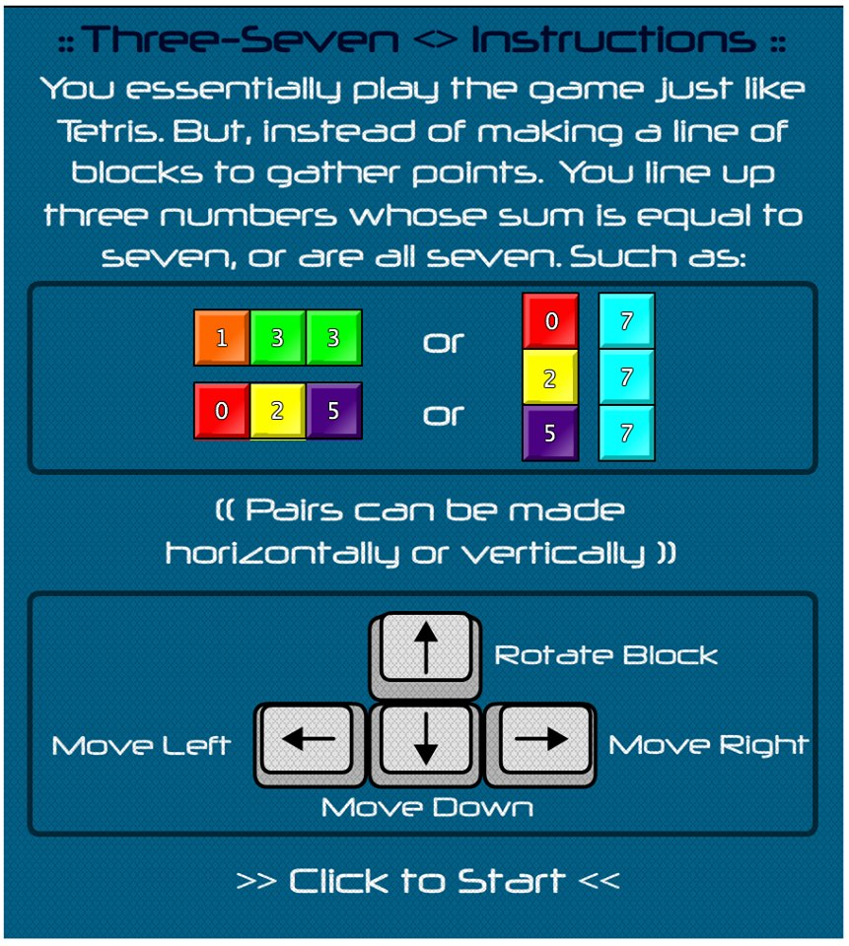
GAME PERSPECTIVE
Traditional Tetris + Dr. Mario
Rule:
Line up three numbers whose sum is equal to seven
Line up three numbers which consists all sevens
Able to use control keys to steer the block
Touch the screen to rotate block
Use finger gesture to steer the block

Slide 7
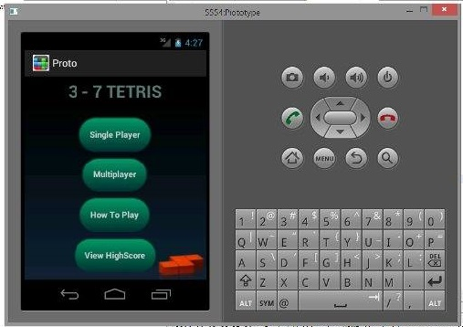
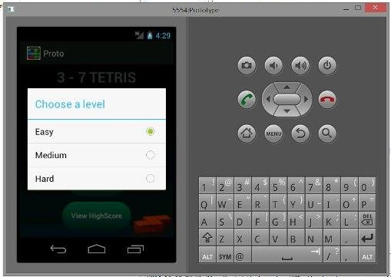
GAME FUNCTIONALITY
It can choose the level of the game.
It can choose game mode.
It can connect with other devices to duel with other player.
It can compare the scare between the players to judge who is the winner.

Slide 8
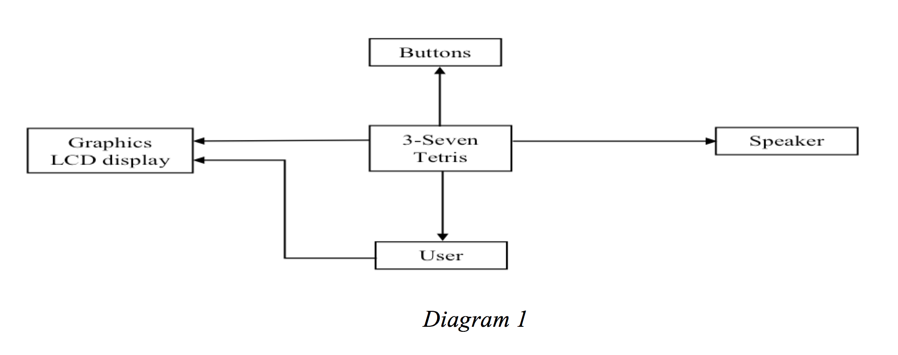
OPERATING ENVIRONMENT
OPERATING SYSTEM: ANDROID 4.0 and above
CONNECTIVITY: Bluetooth
HARDWARE: capacitive display, speaker

Slide 9
DESIGN & IMPLEMENTATION
Only available for Android devices
Only compatible with Android version 4.0 and above
Only compatible with capacitive displays
Bluetooth required for connectivity on multiplayer mode
May or may not be available on Google Play Store (deciding)

Slide 10
ASSUMPTIONS & DEPENDENCIES
Assumptions:
Game system is compatible with android OS version only.
Users need internet to run multiplayer mode.
Game has no serious mistake.
Users understand English.
Devices must have touch screen function.
Dependencies:
It does not need external devices to control such as keyboard and mouse.

Slide 11
SPECIFIC REQUIREMENTS
USER INTERFACE
FUNCTIONAL REQUIREMENT
BEHAVIORAL REQUIREMENT

Slide 12
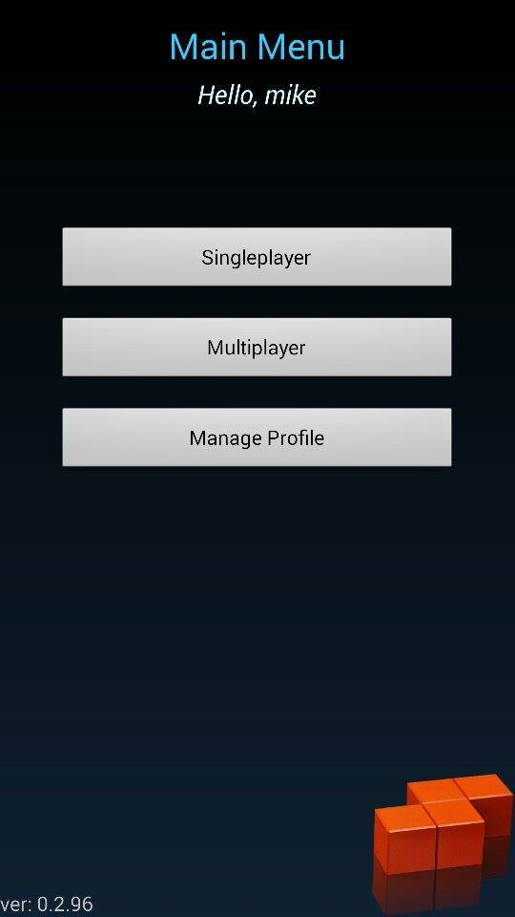
USER INTERFACE
In Figure 1, it shows the main menu interface that having three user options which is:
Single Player
Multiplayer
Manage Profile

Slide 13
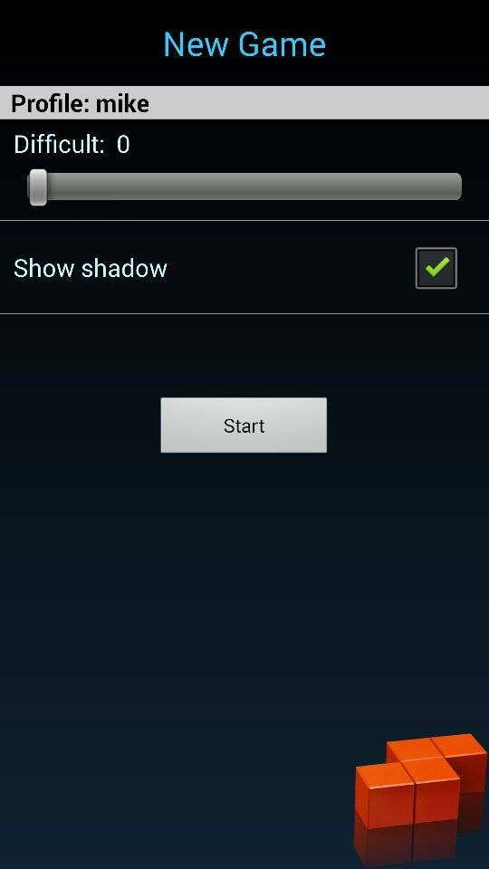
USER INTERFACE
In Figure 2, it shows when user chooses the “Single Player” option. The game will show player on the stat of the game such as difficulty and effects.

Slide 14
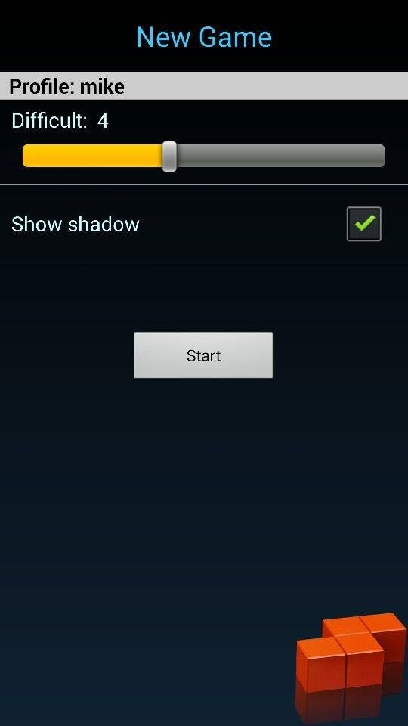
USER INTERFACE
In Figure 3, it shows that player capable of choosing the game’s difficulty by sliding the level slider.

Slide 15
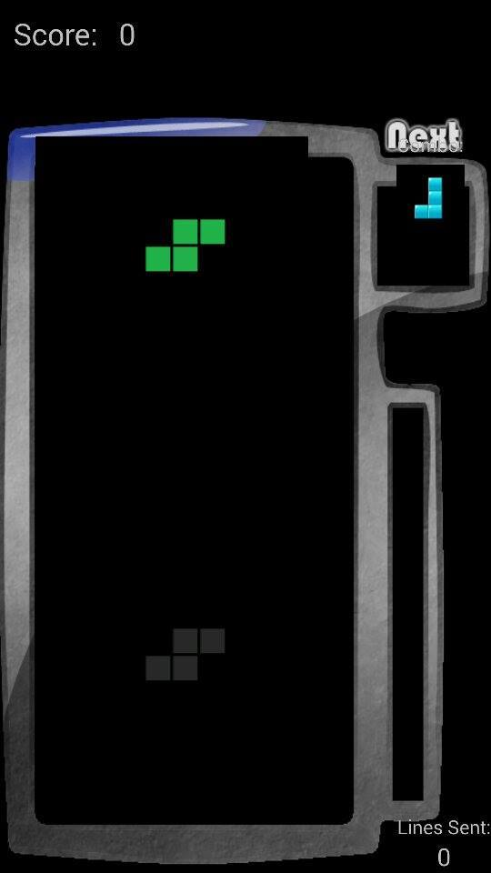
USER INTERFACE
In Figure 4, it shows that user had entered the game environment and playing the game.

Slide 16
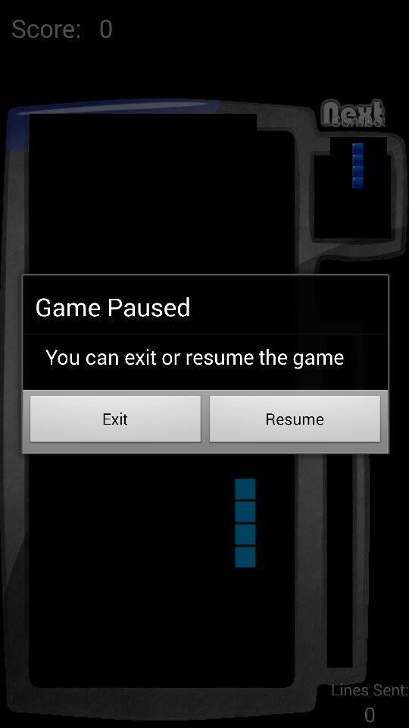
USER INTERFACE
In Figure 5, it shows that the player able to choose whether to quit the game or pause the game by clicking the BACK button of the phone.

Slide 17
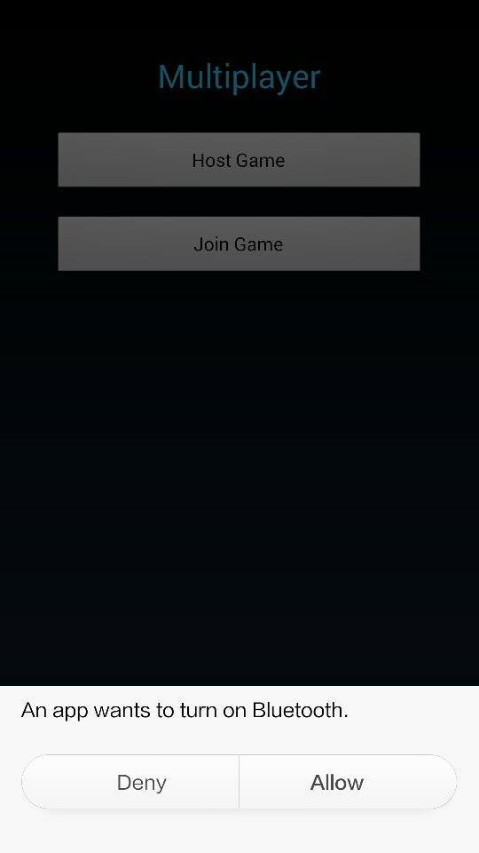
USER INTERFACE
In Figure 6, it shows once player choose “Multiplayer” from the Main Menu. A prompt will show to ask for permission to activate the Bluetooth of the phone for connectivity.

Slide 18
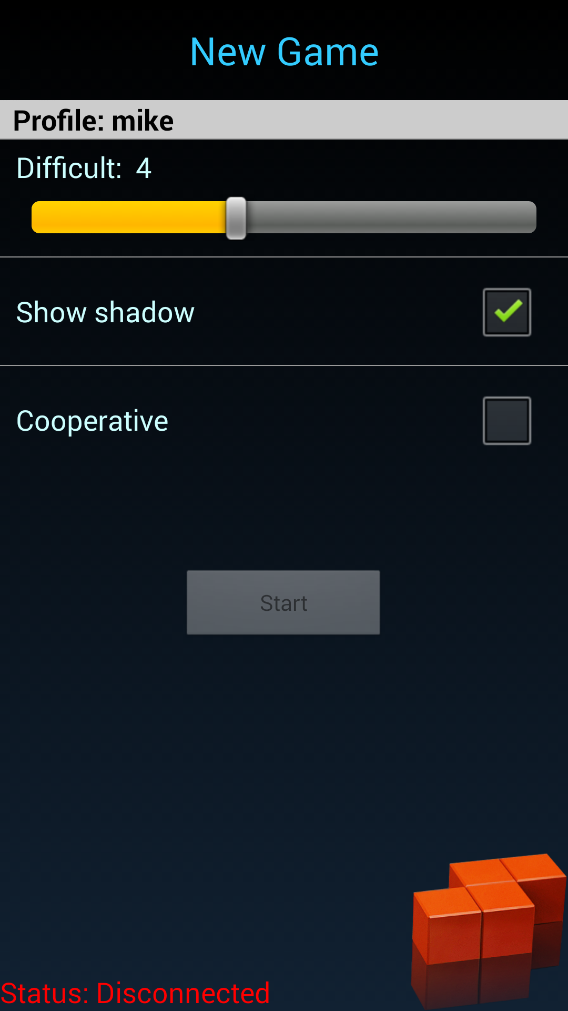
USER INTERFACE
In Figure 7, mode option will appear as so once player chose HOST GAME.
There will be a level bar for level option
There wil be game appearance option
There will be duel option toggle
Connectivity status will be displayed on the screen below

Slide 19
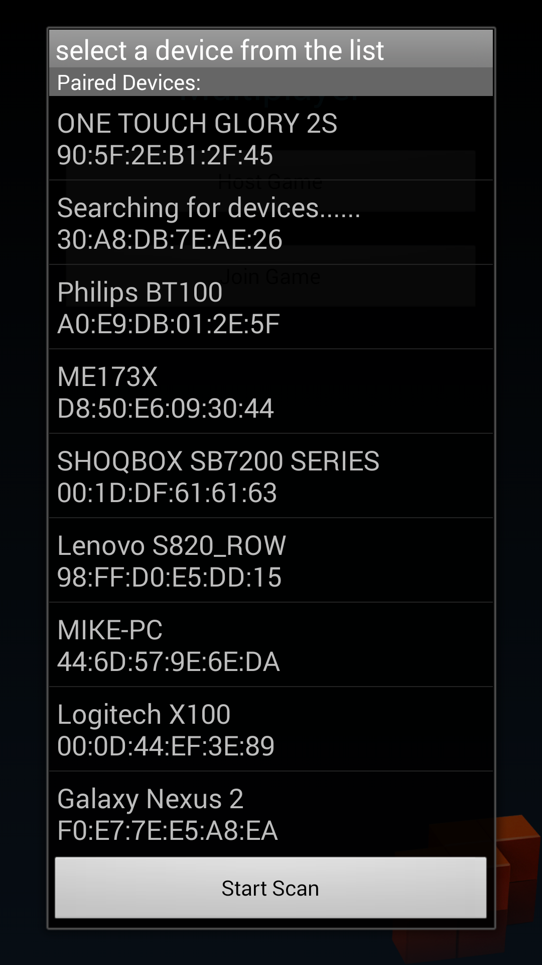
USER INTERFACE
In Figure 8, a list of bluetooth device option will appear as so once player chose JOIN GAME.

Slide 20
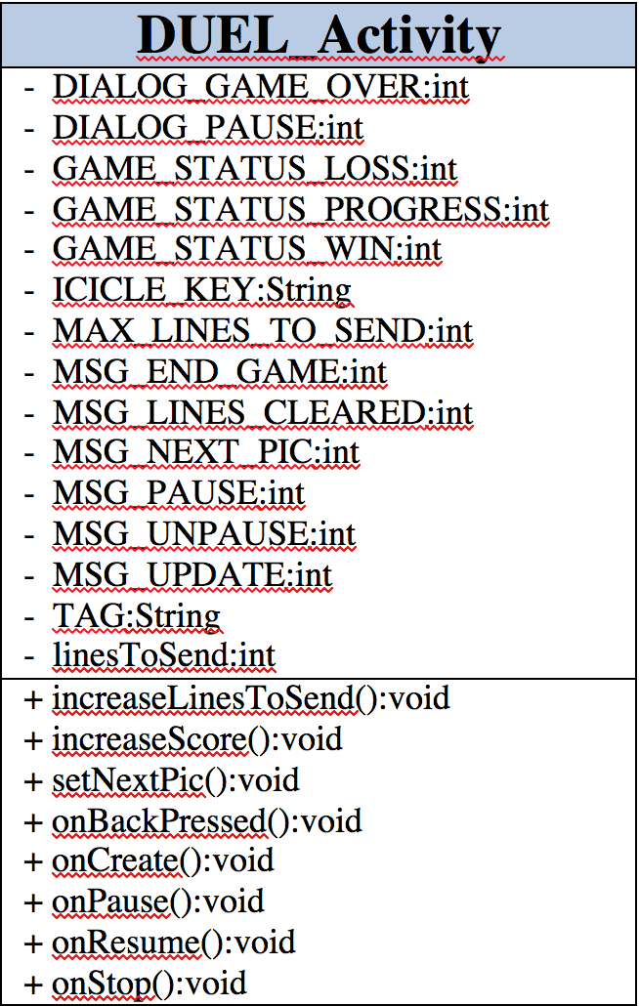
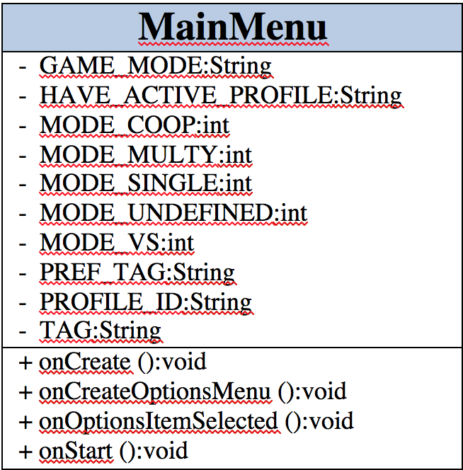
FUNCTIONAL REQUIREMENT

Slide 21
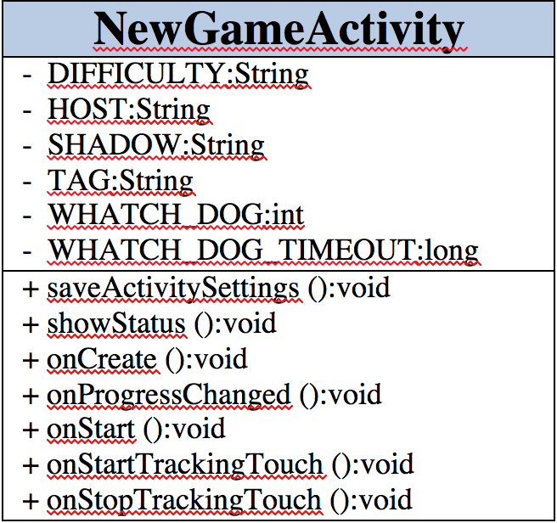
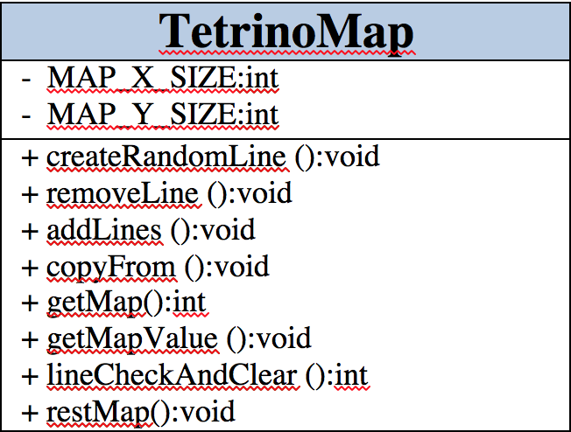
FUNCTIONAL REQUIREMENT

Slide 22
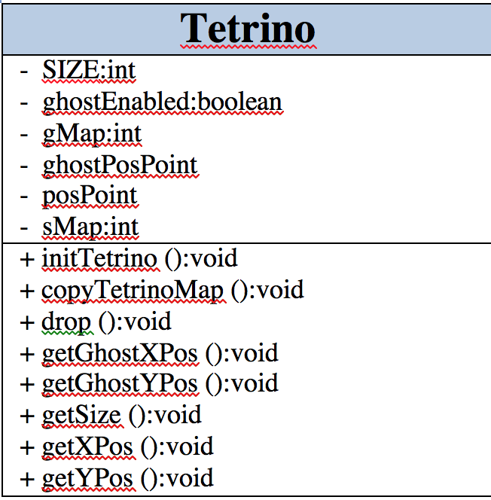
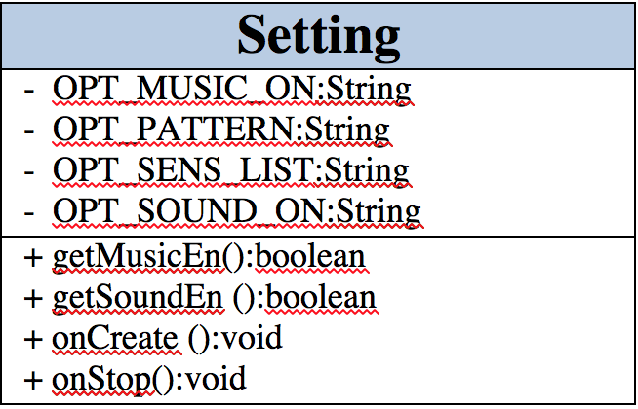
FUNCTIONAL REQUIREMENT

Slide 23
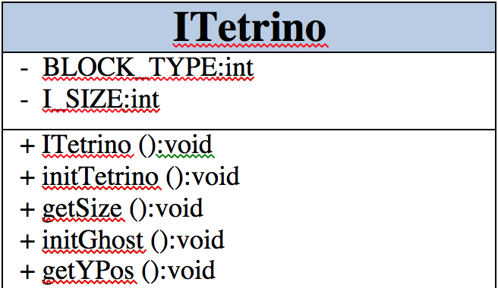
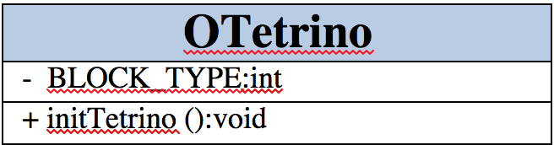
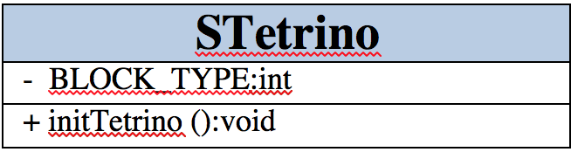
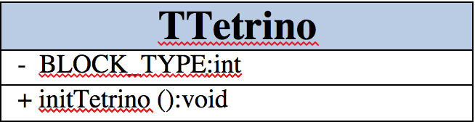
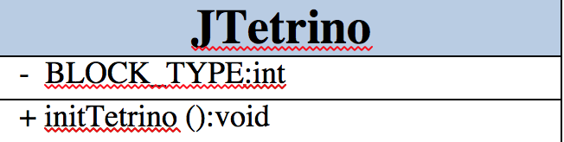
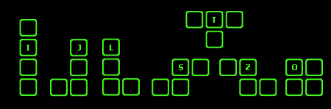
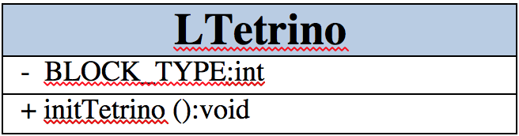
FUNCTIONAL REQUIREMENT

Slide 24
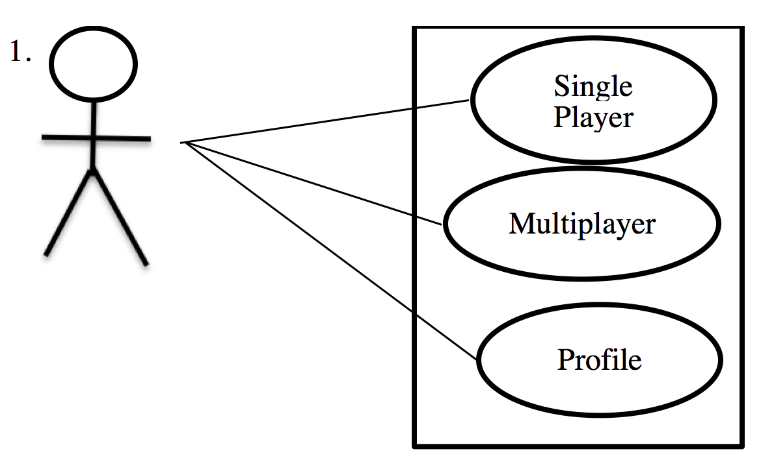
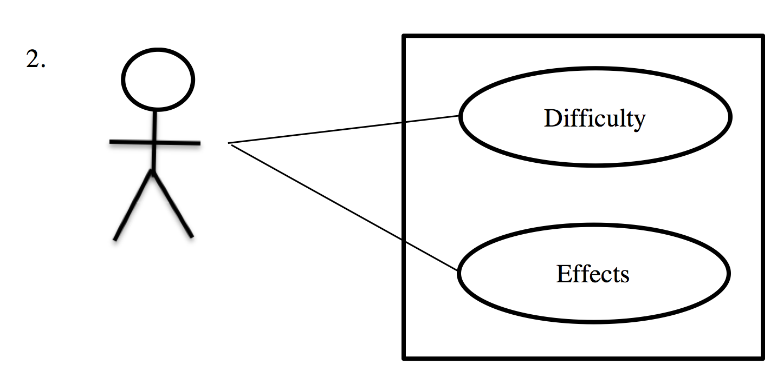
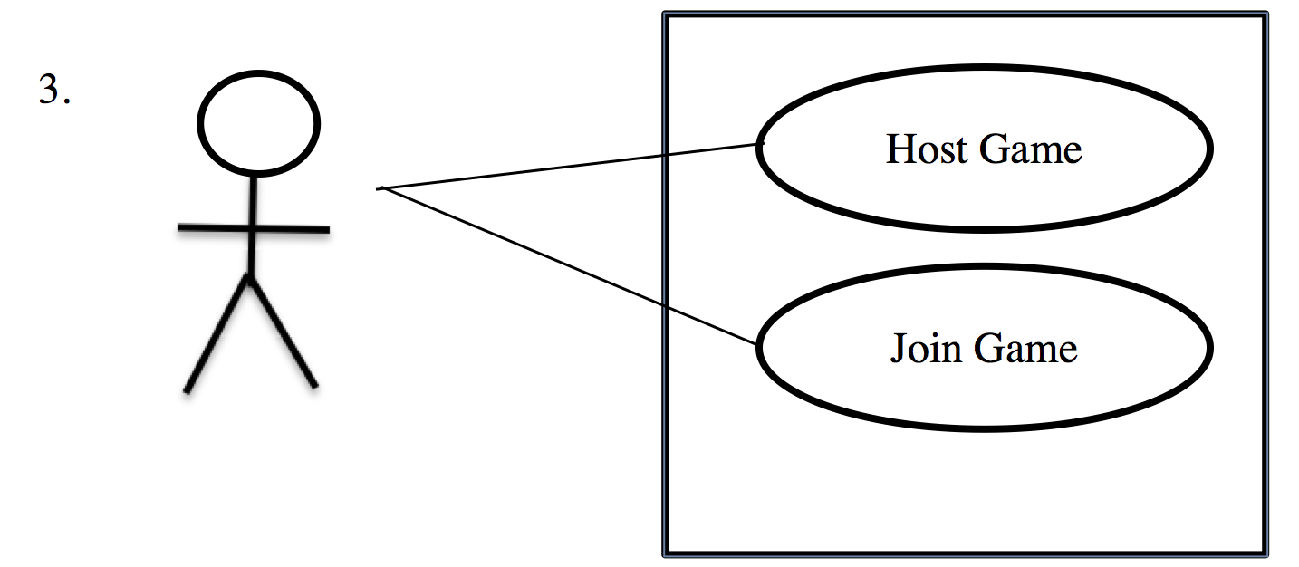
BEHAVIOR REQUIREMENT

Slide 25
OTHER REQUIREMENTS
All-time vertical gameplay view
Time-elapse for Bluetooth pairing (1 minutes), prompt takes action to break pairing method
Number appear in Tetris blocks must be vivid
Fast and smooth performance
No buffer takes place during gameplay

Slide 26
THANK YOU
Q&A SESSION

